Slide 1


Smart Multi-Mode Robotic Car
Smart Multi-Mode Robotic Car
Aim
  To design and develop a smart robotic car capable of:
  Line Following
  Remote Control Operation
  Obstacle Detection and Avoidance
Objectives
  To automate path tracking using IR sensors
  To control the vehicle wirelessly using Bluetooth
  To detect obstacles using Ultrasonic Sensor
  To improve mobility and automation efficiency
Aim
  To design and develop a smart robotic car capable of:
  Line Following
  Remote Control Operation
  Obstacle Detection and Avoidance
24-04-2026
Dept. of E&TC, DYPCOE, Akurdi, Pune
2

Slide 2

Specifications
Specificatios
24-04-2026
Dept. of E&TC, DYPCOE, Akurdi, Pune
3

Slide 3
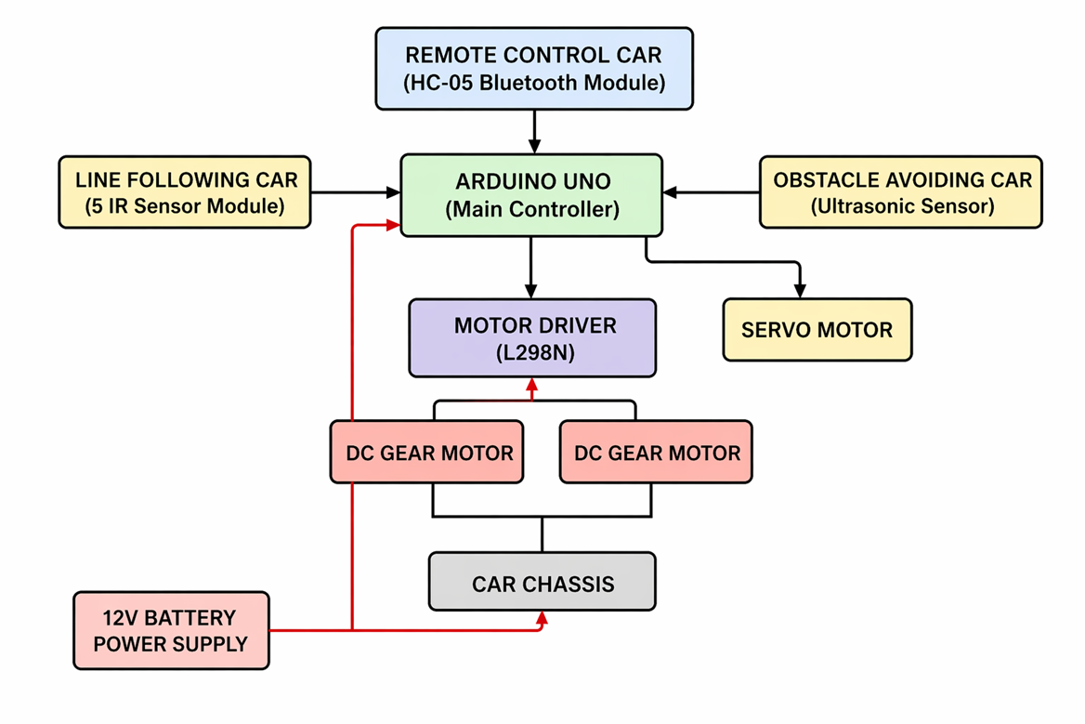
BLOCK DIAGRAM

Slide 4
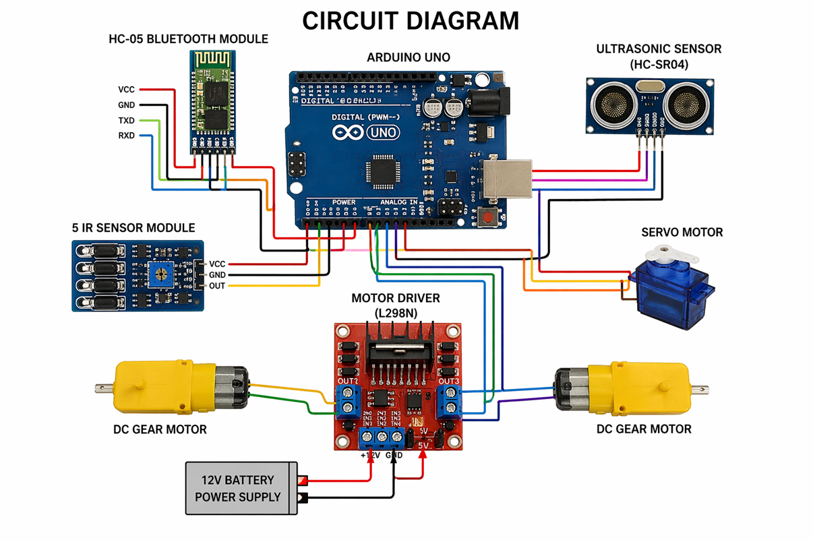
CIRCUIT DIAGRAM

Slide 5

Working Principle
  Remote Control Mode
  User sends commands through mobile Bluetooth app
  Arduino receives signals and controls movement
  Obstacle Avoidance Mode
  Ultrasonic sensor measures obstacle distance
  If object detected, car stops or changes direction
  Line Following Mode
  IR sensors detect black line on white surface
  Arduino processes sensor outputs
  Motors adjust direction accordingly

Slide 6

  SENSOR CALIBRATION PERFORMED
  LINE TRACKING ACCURACY CHECKED
  OBSTACLE DETECTION RANGE TESTED
  BLUETOOTH COMMAND RESPONSE VERIFIED
  MOTOR SPEED AND DIRECTION TESTED

Slide 7

Uses
Advantages
  Fully automated navigation
  Wireless manual control available
  Obstacle prevention improves safety
  Low cost and easy implementation
  Useful for industrial automation
Applications
  Warehouse automation
  Hospital delivery robots
  Smart industrial vehicles
  Military surveillance robots
  Home automation projects

Slide 8
CONCLUSION
•The project successfully integrates:
•Line Following
•Obstacle Avoidance
•Remote Control System
•into a single smart robotic vehicle.
•It demonstrates practical implementation of embedded systems and automation technologies.

Slide 9
REFERENCES
  [1] Arduino, “Arduino UNO Rev3,” Arduino Official Documentation, available: Arduino.cc.
  [2] HC-05 Bluetooth Module, “HC-05 Bluetooth to Serial Port Module Datasheet,” Wireless Communication Module Technical Guide.
  [3] STMicroelectronics, “L298N Dual H-Bridge Motor Driver Datasheet,” Motor Driver IC Technical Documentation.
  [4] HC-SR04, “Ultrasonic Distance Sensor Module Datasheet,” Obstacle Detection Sensor Technical Manual.
  [5] IR Sensor Module, “Infrared Line Following Sensor Module Datasheet,” Line Tracking Sensor Guide.
  [6] TowerPro, “SG90 Micro Servo Motor Datasheet,” Servo Motor Technical Specifications.
  [7] BO Motor, “DC Gear Motor Technical Datasheet,” Smart Car Wheel Drive Motor Documentation.

